Slide 1


MelodyHub
A music streaming platform
Team:
Abhiyan Sainju
Bhavana Thakare
Rakshitha Mamilla
Udaykiran Kalyanapu
Course:
Object Oriented Design
CSCI 6234_10

Slide 2
Project Vision
MelodyHub offers seamless music streaming, playlist management, and artist-listener interaction.
Built with Node.js and MongoDB using OOP principles.
Key Features: Real-time chat, playlist sharing, artist uploads.
Benefits of OOP: Code reusability, scalability, and maintainability.
2

Slide 3
Project Objectives
Design and implement a music streaming platform with OOP best practices.
Provide a seamless experience for users to stream music, manage playlists, and interact.
Ensure code modularity and scalability through proper OOP design.
Integrate real-time chat for enhanced user interaction.
Develop a functional prototype with a well-defined architecture.
2

Slide 4
Project Requirements

Slide 5
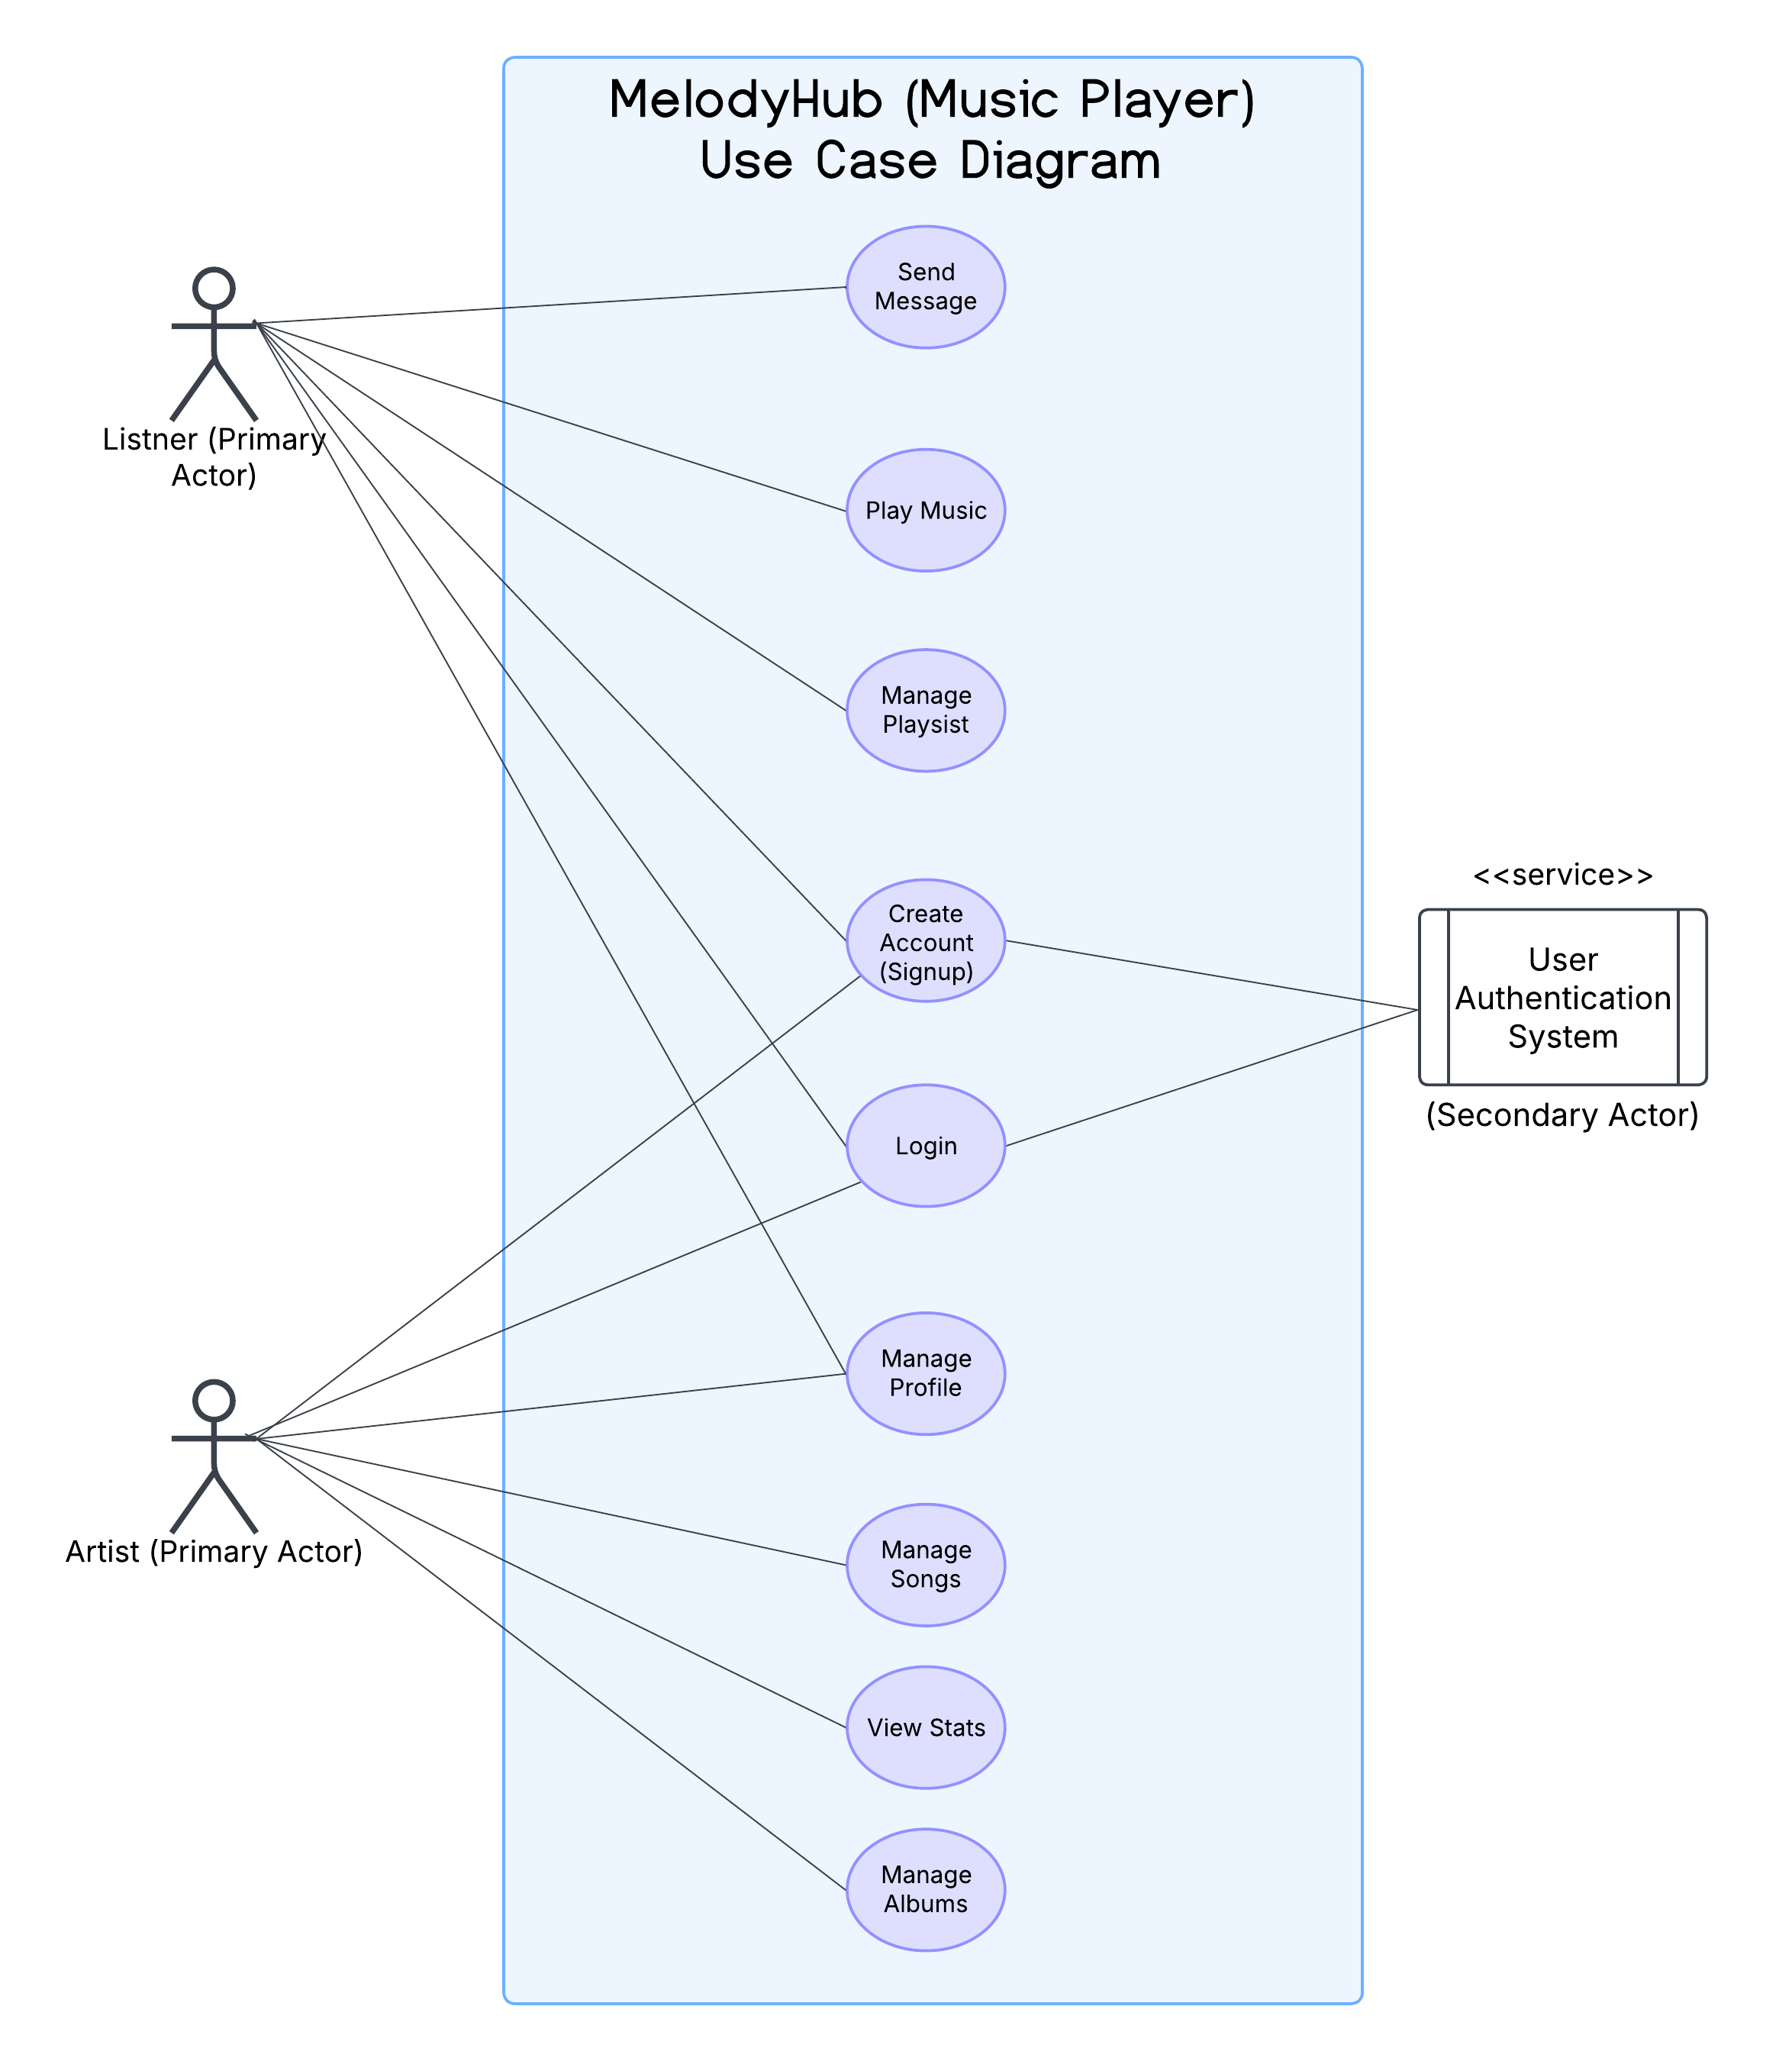
Use Case Diagram

Slide 6
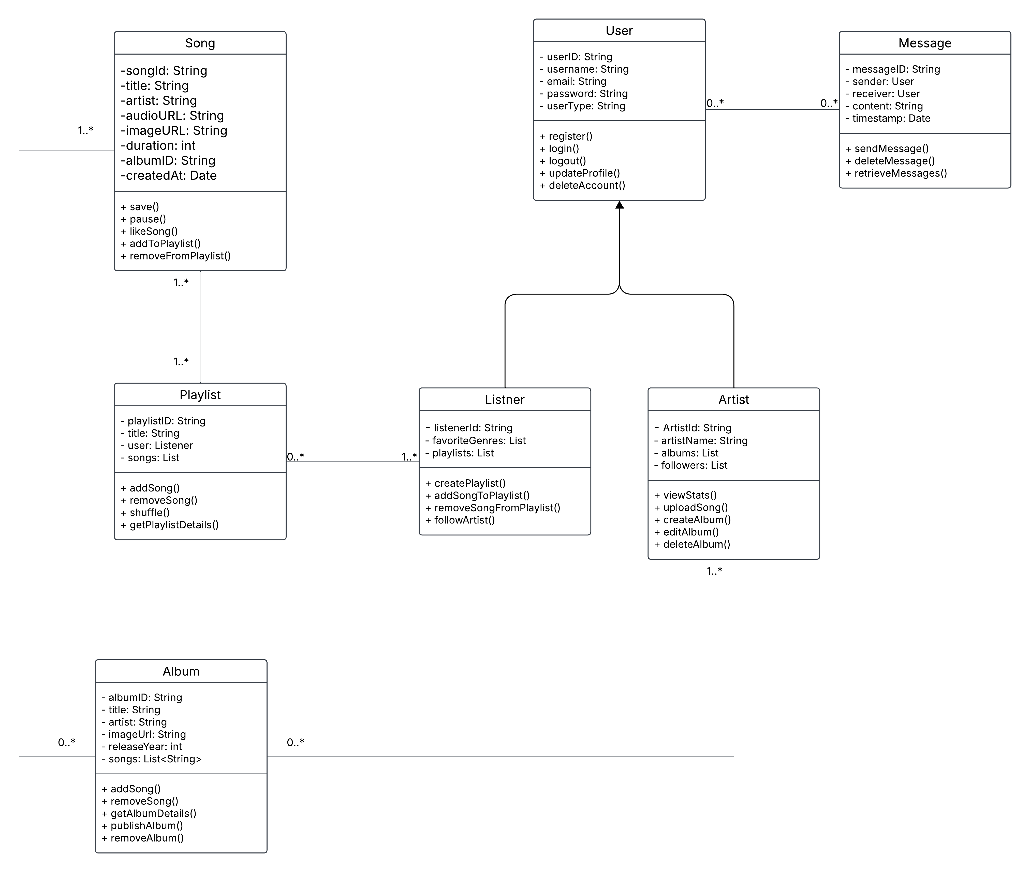
Class Diagram

Slide 7
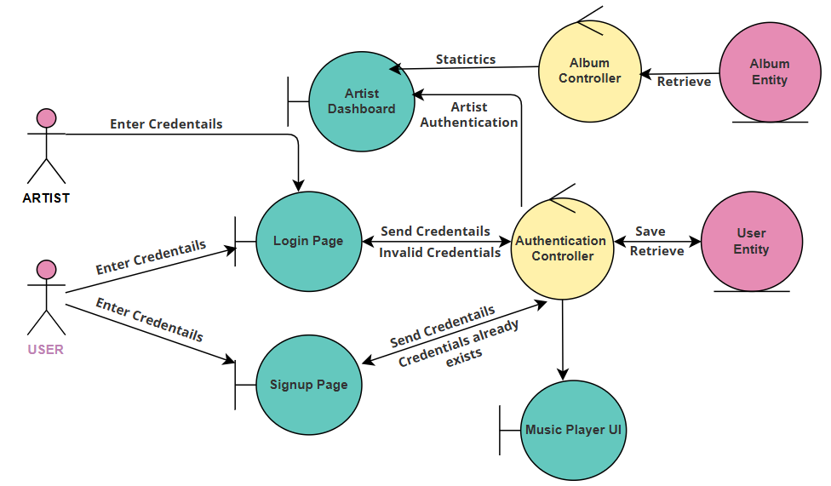
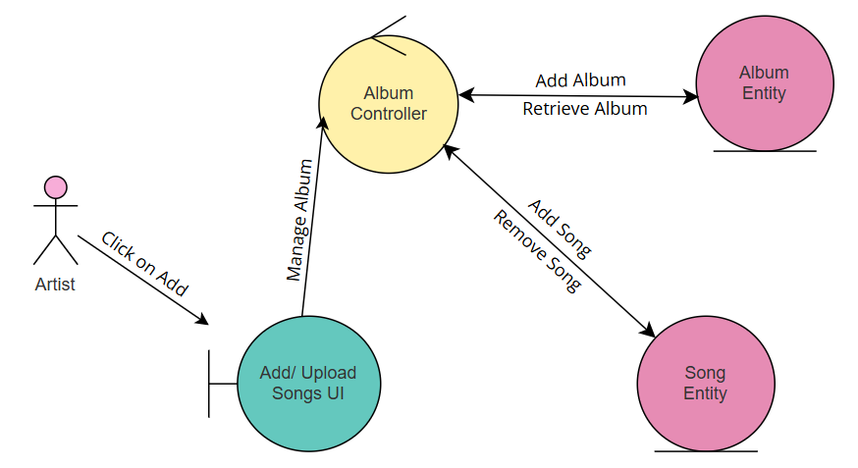
Robustness Diagrams
Add Song
Login

Slide 8
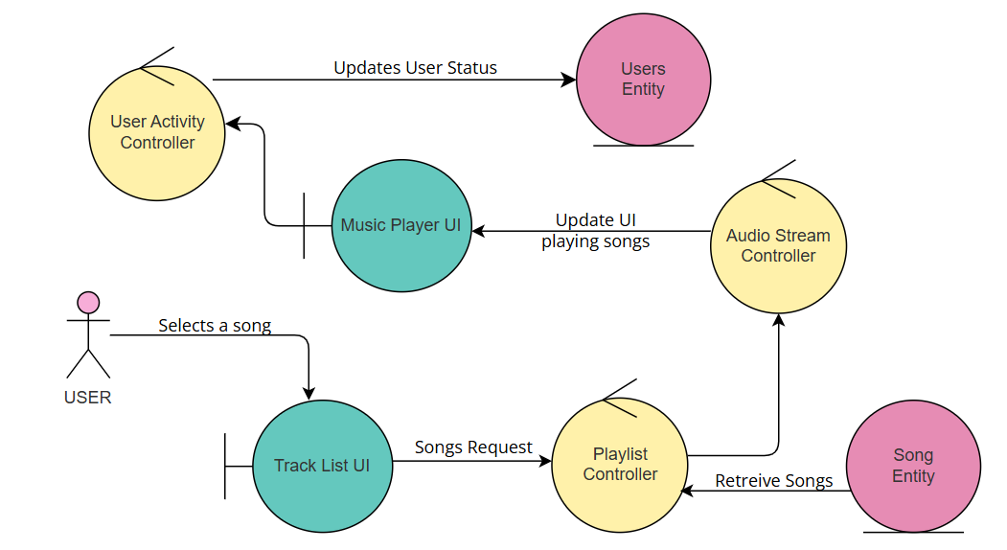
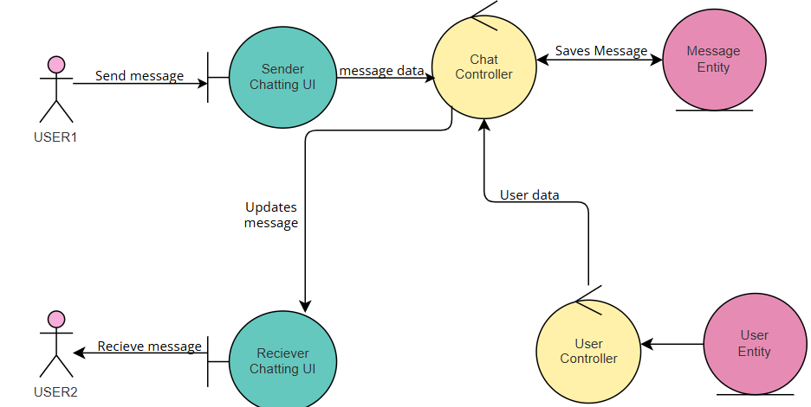
Robustness Diagrams
Play Music
Send Message

Slide 9
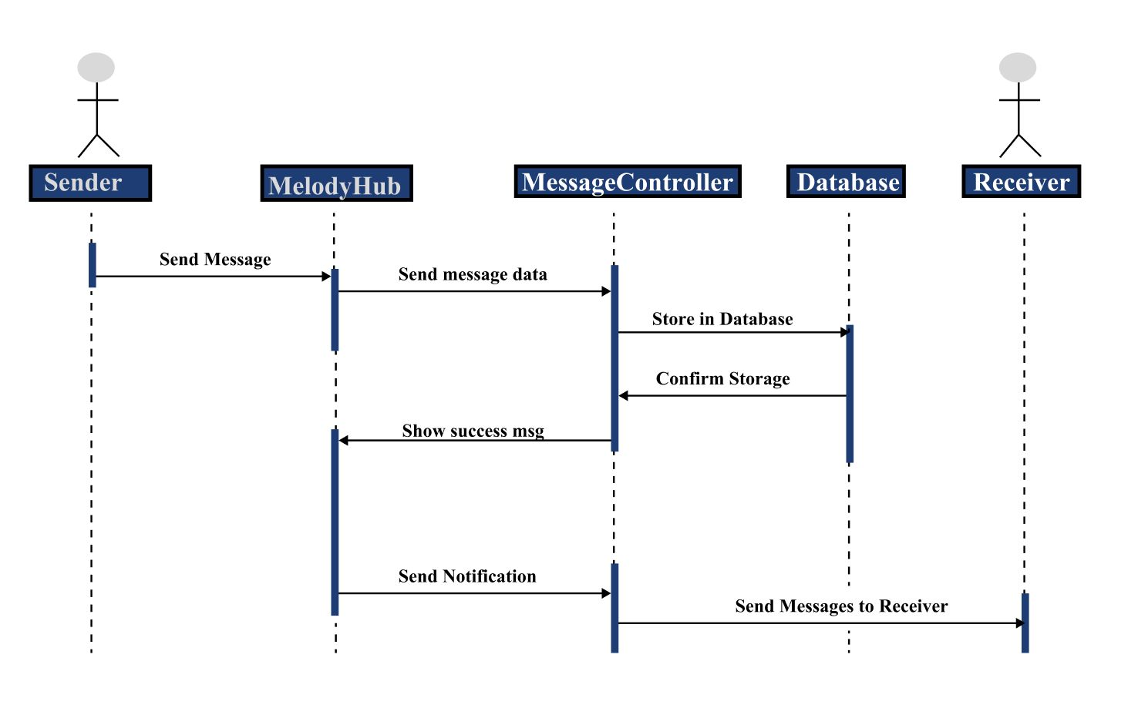
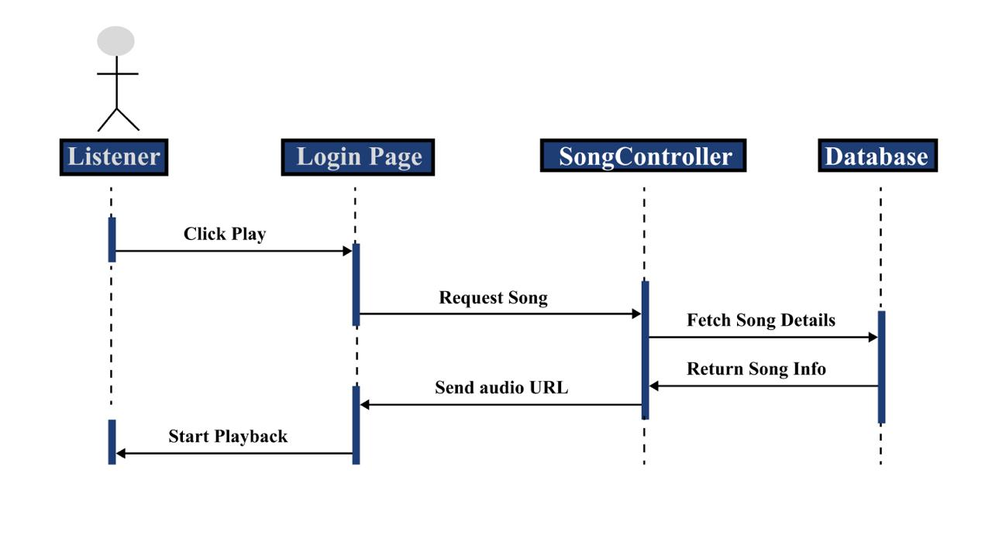
Sequence Diagrams
Play Music
Send Message

Slide 10
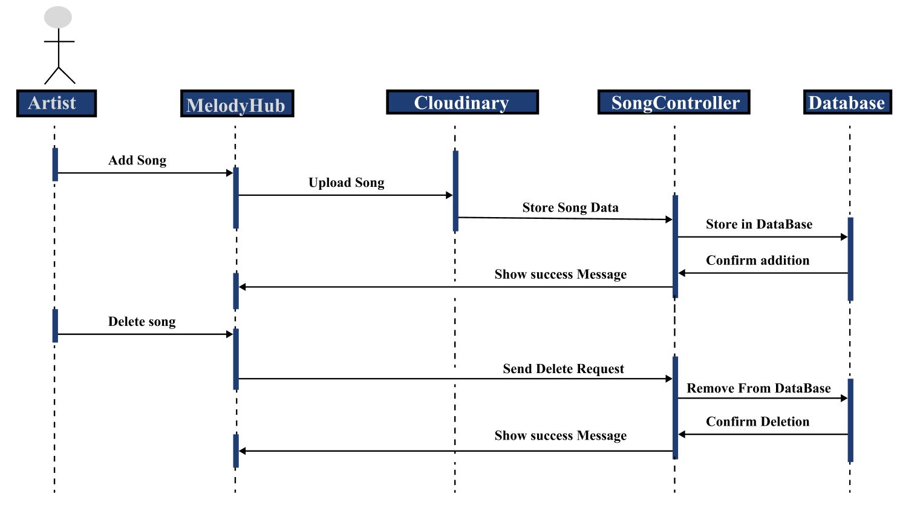
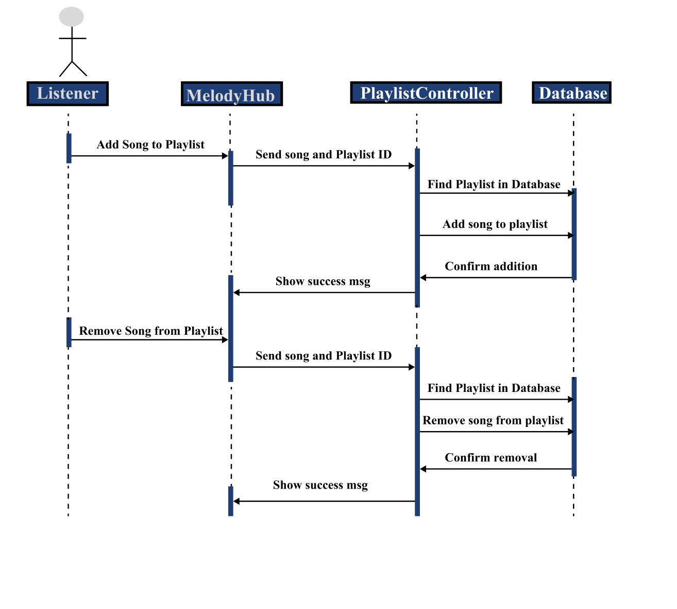
Sequence Diagrams
Manage Songs
Send Message

Slide 11








Tools and Platforms Used
HTML
JS
CSS
Tailwind CSS
React
Node
VS Code
Git

Slide 12
Prototype Design

Slide 13
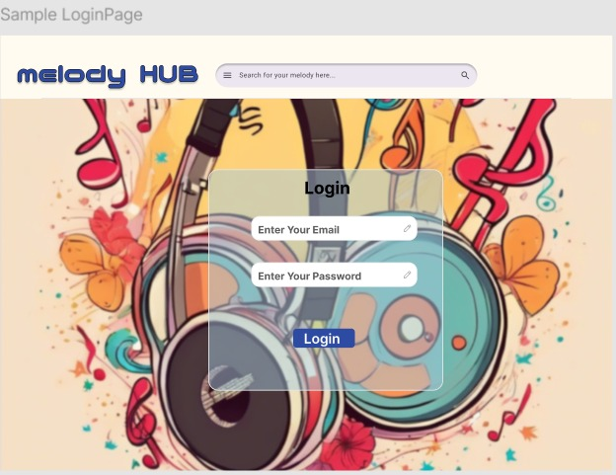
Login Page

Slide 14
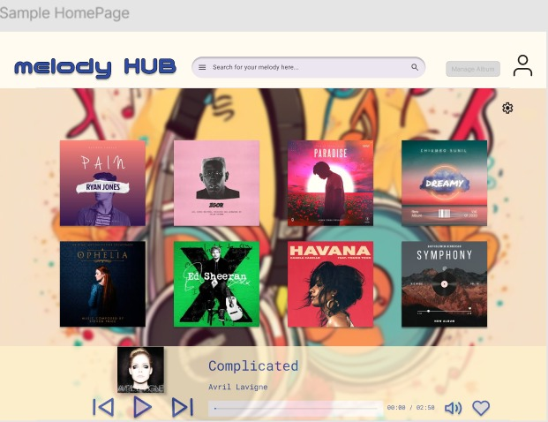
Homepage

Slide 15
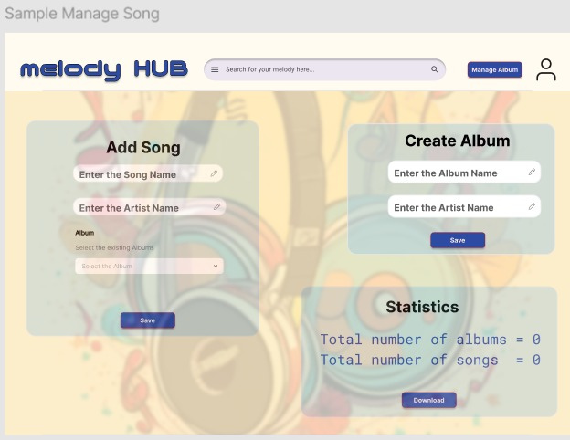
Artist’s Album Manage Section

Slide 16
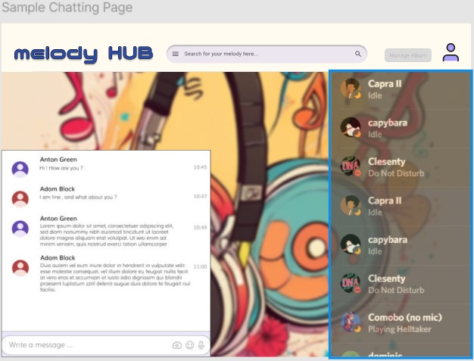
Chat Section

Slide 17
Conclusion
Project Goals: To build a scalable and interactive music platform.
Objective: Implement core music streaming functions, real-time chat, and OOP-based architecture.
Future Work: Adding social networking features, mobile application development, enhancing search capabilities.
Abhiyan Sainju (15166/074) 19

Slide 18
Thank You

Slide 19
Credits
Special thanks to all the people who made and released these awesome resources for free:
Presentation template by SlidesCarnival
Photographs by Unsplash
Illustrations by Undraw.co

